Slide 1
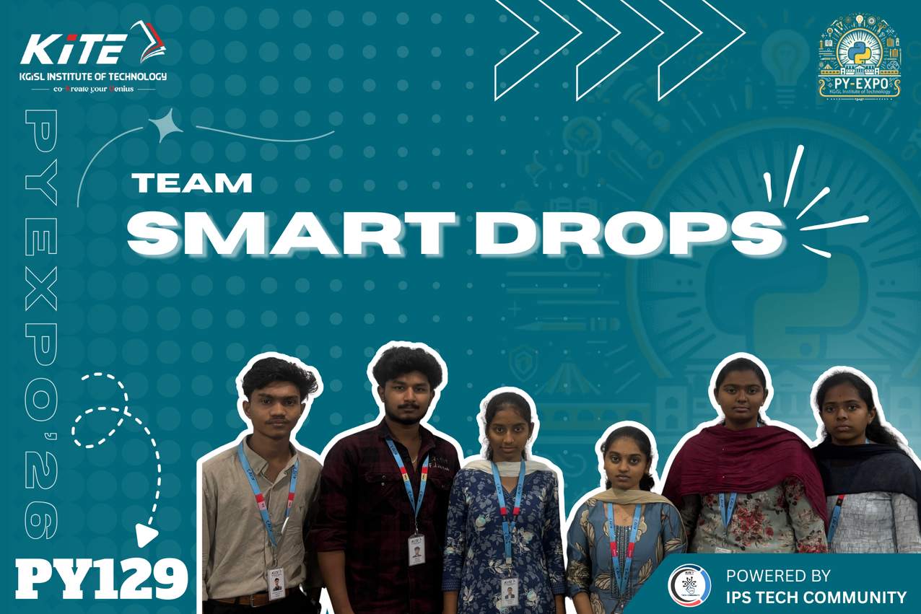
Team Members:
MOHAMED ARSHATHM
SANJAY K
VAISIKA P
SONIKA M
RAKSHITHA K S
SAI RAGAVI A C
Project Title: Smart irrigation
Problem Description:
The Smart Irrigation System is a hardware-based and web-enabled irrigation monitoring system that uses sensors to detect temperature, humidity, soil moisture, and water flow in agricultural fields. The hardware sensors collect real-time data, which is displayed channel-wise on a web dashboard for monitoring. The system automatically turns on the water pump when soil moisture is low, and users can also manually control the pump through the web application. If the system detects that water is not reaching a particular area, it sends an alert notification. This project helps in efficient water management and smart irrigation control.

